Slide 1
API Testing

Slide 2
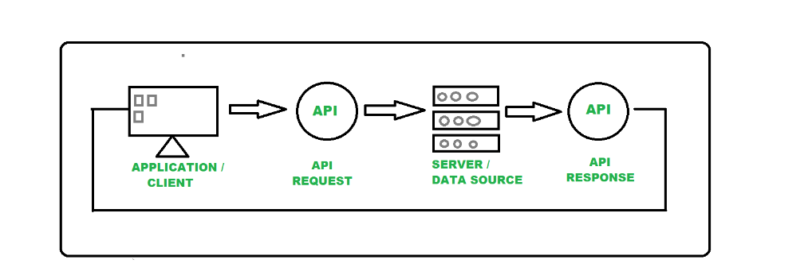
Architecture of API Testing

Slide 3
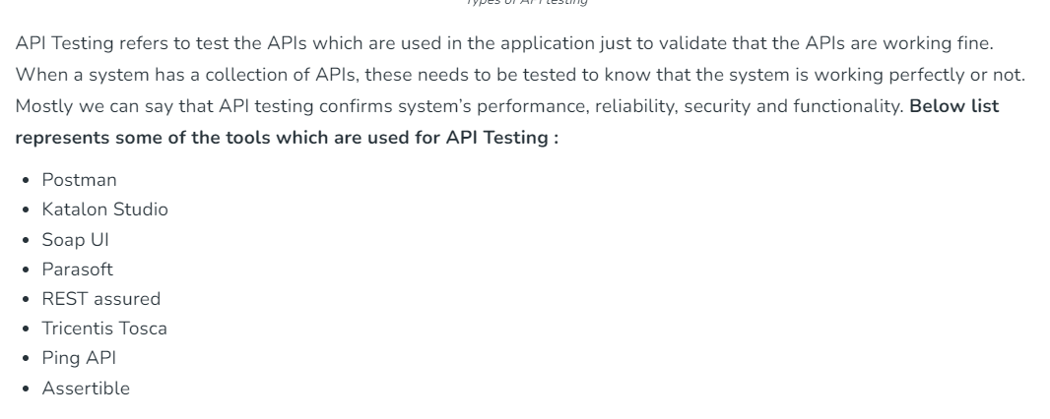
Types of Tool for API Testing

Slide 4
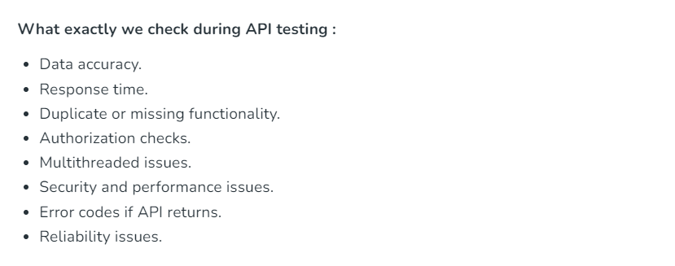
What we Check in API testing

Slide 5
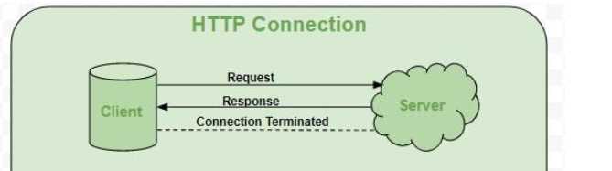
Protocol in API Testing
Http
HTTP stands for HyperText Transfer Protocol. It is invented by Tim Berner. HyperText is the type of text which is specially coded with the help of some standard coding language called HyperText Markup Language (HTML). HTTP provides a standard between a web browser and a web server to establish communication. It is a set of rules for transferring data from one computer to another. Data such as text, images, and other multimedia files are shared on the World Wide Web

Slide 6
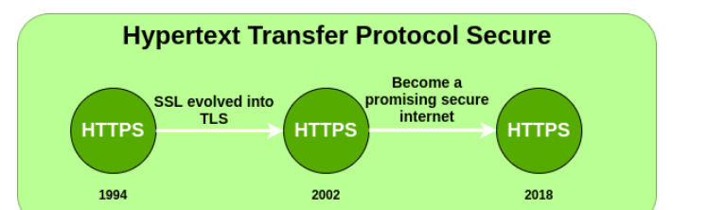
Protocol in API Testing
Https
HTTPS stands for Hyper Text Transfer Protocol Secure. HTTP Secure (HTTPS), could be a combination of the Hypertext Transfer Protocol with the SSL/TLS convention to supply encrypted communication and secure distinguishing proof of an arranged web server. HTTPS is more secure than HTTP because HTTPS is certified by the SSL(Secure Socket Layer). Whatever website you are visiting on the internet, if its URL is HTTP, then that website is not secure.

Slide 7
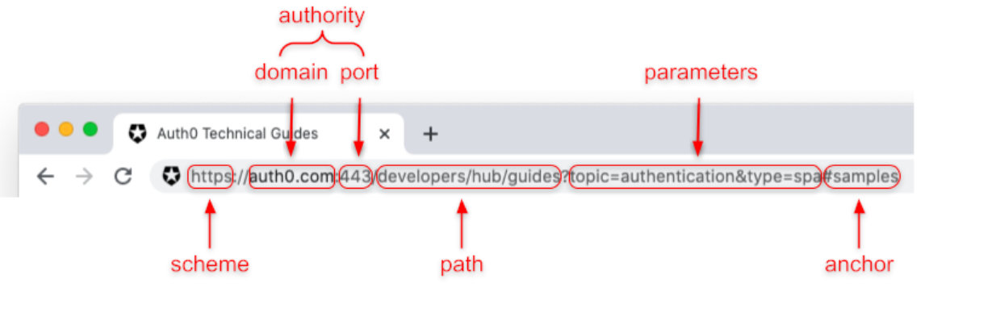
What is an URL
URL is an acronym that stands for Uniform Resource Locator. Maybe the expanded name may sound weird, but you can simply call it address. The term address explains very well the role of a URL. You can think of a URL like your home address: it contains all the information to find your home.
Similarly, you can define a URL as a string that denotes the location of a given resource on the Internet: a web page, an image, a mailbox, etc

Slide 8
URI
The URI acronym stands for Uniform Resource Identifier. Shortly, it is a string that identifies a resource. From a syntactical point of view, a URI string mostly follows the same format as... the URL
Both URLs and URIs follow the same specification: RFC 3986. However, while URLs allow you to locate a resource, a URI simply identifies a resource. This means that a URI is not necessarily intended as an address to get a resource. It is meant just as an identifier.
Going back to the address example, if you say you live in the only yellow house in your town, you are not giving directions on how to get there. However, this information identifies your house among the others in your town.

Slide 9
Example of URL
https://www.hostinger.com/
https://www.hostinger.com/ and typing it on a browser’s address bar will lead users to our site. The same rule applies to
https://www.microsoft.com/
https://www.microsoft.com/ and
https://www.linux.org/
https://www.linux.org/.

Slide 10
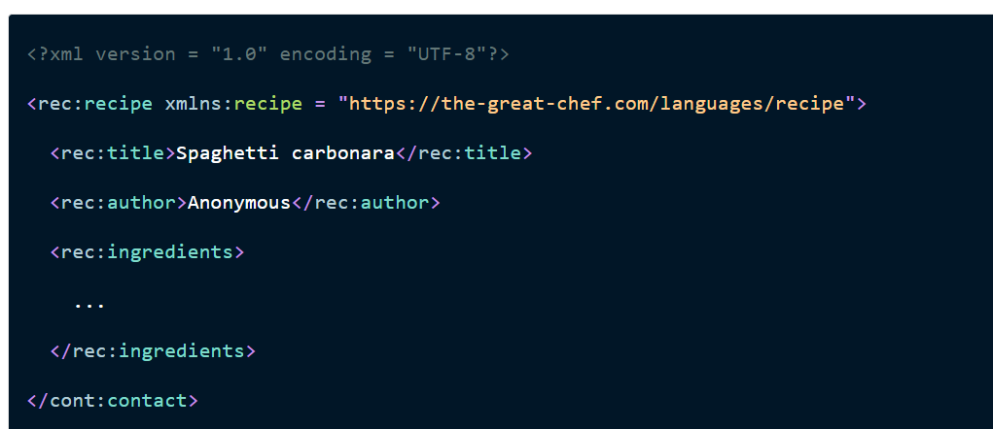
URI Example

Slide 11
Base URI and base path
We all know about Google whose URL is ” https://www.google.com/“. Actually this is base URI of Google. Now append “/maps” in last of base url “https://www.google.com/” as “https://www.google.com/maps“. Google will launch Google Maps. Try same with “/news”. Google will launch Google News. Here “Maps” and “News” are actually resources which are called as base path. So to summarize, BaseURI is the address where different resources are located. A Base Path which is appended with BaseURI to locate a resource.
Another Examples is
https://demoqa.com/BookStore/v1/Books

Slide 12
API Endpoint
An API endpoint is where an API receives requests. For most services, these endpoints are URLs, just like the ones you use to navigate to a website.
Let’s take a closer look at how API endpoints work. Here’s an example of an endpoint URL:
https://api.github.com/
repos/torvalds/linux
This endpoint belongs to the GitHub REST API and returns information about a repository as a JSON object.
API endpoints have a base path that’s usually a dedicated subdomain, like cdn.contentful.com, graphql.contentful.com, or https://collectionapi.metmuseum.org/. They can also be presented as paths within the main site, like https://mandrillapp.com/api but it’s rarer.

Slide 13
Authentication and authorization
APIs represent points of access to data, which can be valuable or highly sensitive. APIs can also provide access to software functionality. Without API authentication, unknown and untrusted users can get access to the data or functionality the API provides. Risks include data breach, corruption or deletion of data, and denial of service (DoS) attacks
API authentication reduces the likelihood of such attacks. It can also mitigate their impact should an attack occur. API authentication also leads to greater user trust. In many use cases, especially those that involve financial information or personal data, users actually like it when API authentication is in effect, even if the process adds extra steps to log in. It makes them feel more confident that their data is being protected.

Slide 14
Authentication and authorization
API Authentication works through the presentation of a credential and/or supporting data points, followed by its acceptance or rejection.
The credential can be an API key, a username/password pair, or a digital token. Supporting data points can be information related to the user’s device or location. For example, if a user is based in Boston, but the device using her credentials is located in London, then the user claiming the identity may not be who she says she is. Either the user went to London, or someone is spoofing her device. A good API authentication solution, properly configured, should be able to detect such anomalies and respond to them by blocking the user—at least until further verification steps, like one-time passwords, can be taken.

Slide 15
AUTHorization
Authentication alone is not enough to ensure API security. After all, authentication only establishes a user’s identity. It does not determine what kind of API access he or she is entitled to have. That is a matter of authorization. It’s like the difference between a key to a building and a key to a room inside that building. The first key gets you in. That’s authentication. The second key lets you into a specific room. That’s authorization. With APIs, authorization is about what level of access the user is entitled to receive

Slide 16
Types of api authentication
HTTP Basic Authentication — Considered the simplest form of API authentication, it only requires users to have a username and password created with Base64 encoding. There are no session IDs or cookies. The method uses the HTTP header, making it quite simple and straightforward. No other solutions are needed.
API Key Authentication — Created to make up for the weakness of shared credentials, which made HTTP Basic Authentication a deficient approach to authentication. With API key authentication, the API security solution authenticates the API key, at which point the server confirms the user’s identity and allows him to access the API. The API key is sometimes called a ‘bearer token’. The rationale is that if you have the token (are the bearer of the token) you can ‘talk’ to the API.
OAuth Authentication — Able to handle authorization as well as authentication. The API requests authentication, which takes the form of an OAuth token that is forwarded to an authentication server, which accepts or rejects it. The token has limited allowed uses and often an expiration time

Slide 17
Path parameters
Path parameters are request parameters attached to a URL that point to a specific REST API resource. The path parameter is separated from the URL by a `/`, and from the query parameter(s) by a question mark (`?`). The path parameter defines the resource location, while the query parameter defines sort, pagination, or filter operations
Path parameters are part of the endpoint and are required. For example, `/users/{id}`, `{id}` is the path parameter of the endpoint `/users`- it is pointing to a specific user's record. An endpoint can have multiple path parameters, like in the example `/organizations/{orgId}/members/{memberId}`. This would be pointing to a specific member's record within a specific organization, with both `{orgID}` and `{memberID}` requiring variables.

Slide 18
Query parameters
Query parameters are parameters attached to the end of a URL and separated from the URL by a question mark (?). The section before the question mark is the path parameter, and the section after the question mark is the query.
The path parameter defines the resource location, while the query parameter defines sort, pagination, or filter operations. The user's input (the query) is passed as a variable in the query parameter.
For example, if we search `abstract api` in the search box at `www.google.com`, the result URL is a monstrous string:
`https://www.google.com/search?q=abstract+api&rlz=1C1CHBF_enUS923US923&oq=abstract+api&aqs=chrome..69i57j0i10i433j0j0i10i433j0i10l6.1705j0j7&sourceid=chrome&ie=UTF-8`

Slide 19
Cookies
API cookies, often referred to as HTTP cookies or web cookies, are small pieces of data that a web server sends to a client's browser and are stored on the client's device. These cookies are used to track and store information about the user's interactions with a website or web application. They play a crucial role in maintaining user sessions, personalizing experiences, and enhancing security.
Advantages of API Cookies
The foremost advantage of API cookies lies in their ability to streamline client-server authentication and session management in API usage. They offer:
Simplification of the authentication process.
No need for clients to remember authentication information.
Ease of session management.
API cookies operate by managing authentication tokens on the user side, simplifying the authentication process and easing client-side implementation.

Slide 20
Api cookies disadvantages
Disadvantages of API Cookies
On the flip side, using API cookies can introduce security concerns and other drawbacks:
Security risks.
Potential for cookie theft or tampering.
Possibility of sudden access loss due to expiration.
Server-side burden in managing cookies.
Cookies, including API cookies, are relatively high-security risk, especially since they are effective within a defined period. If an API cookie is stolen during this period, unauthorized access becomes possible. Thus, using API cookies requires robust security measures and careful server-side management.

Slide 21
What are http headers
HTTP headers contain metadata in key-value pairs that are sent along with HTTP requests and responses. They can be used to define caching behavior, facilitate authentication, and manage session state. HTTP headers help the API client and server communicate more effectively—and enable developers to optimize and customize the API’s behavior.
HTTP headers play a crucial role in server and client behavior throughout the request and response cycle. Request headers are sent by the client to the server and contain information and instructions related to the requested resource, while response headers are sent by the server to the client and provide metadata, instructions, and additional information about the response itself.

Slide 22
Some common http headers
Accept
The Accept header defines the media types that the client is able to accept from the server. For instance, Accept: application/json, text/html indicates that the client prefers JSON or HTML responses.
User Agent
The User-Agent header identifies the web browser or client application that is making the request, which enables the server to tailor its response to the client. For instance, if the User-Agent header indicates that the request is coming from the Chrome browser, the server may include CSS prefixes for CSS properties that are compatible with Chrome.

Slide 23
Some common http headers
Authorization
The Authorization header is used to send the client’s credentials to the server when the client is attempting to access a protected resource. For instance, the client might include a JSON Web Token (JWT) as the value of the header, which the server will then verify before returning the requested resource.
Content-Type
The Content-Type header identifies the media type of the content in the request body. For instance, Content-Type: application/json indicates that the request body contains JSON data. This information helps the server successfully interpret and process the payload.

Slide 24
Some common http headers
Cookie
The client can use the Cookie header to send previously stored cookies back to the server. The server then uses these cookies to associate the request with a specific user or session. This header plays an important role in delivering personalized experiences, as it enables the server to remember a user’s login state or language preference.

Slide 25
API Response codes
100 Series
These are temporary responses
100 Continue
101 Switching Protocols
102 Processing

Slide 26
API Response codes
200 Series
Success Codes
200 – OK
201 – Created
202 – Accepted
203 – Non-Authoritative Information
204 – No Content

Slide 27
API Response codes
300 Series
Redirectional Codes
300 – Multiple Choices
301 – Moved Permanently
302 – Found
303 – Check Other
304 – Not Modified

Slide 28
API Response codes
400 Series
Client Side Error
400 – Bad Request
401 – Unauthorised
402 – Payment Required
403 – Forbidden
404 – Not Found
405 – Method Not Allowed

Slide 29
API RESPONSE CODES
These are Server side Error
500 – Internal Server Error
501 – Not Implemented
502 – Bad Gateway
503 – Service Unavailable
504 – Gateway Timeout

Slide 30
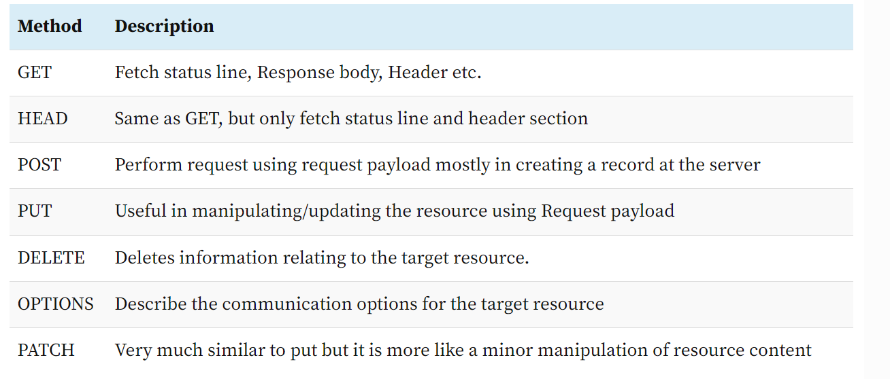
HTTP METHODS

